Slide 1
Future of Wind Turbines and Viewsheds: A quantitative Approach
Open-Source Python library for Visual Impact Assessment (VIA) of Onshore Wind Turbine Projects
Chinna Subbaraya Siddharth Ramavajjala, MSc Cartography and GIS, Dept of Geography

Slide 2
Overview
Introduction (Problem Statement)
The Problem
The Solution
GIS Workflow
Live Demo
Future work
Chinna Subbaraya Siddharth Ramavajjala, MSc GIS & Cartography, Dept of Geography

Slide 3
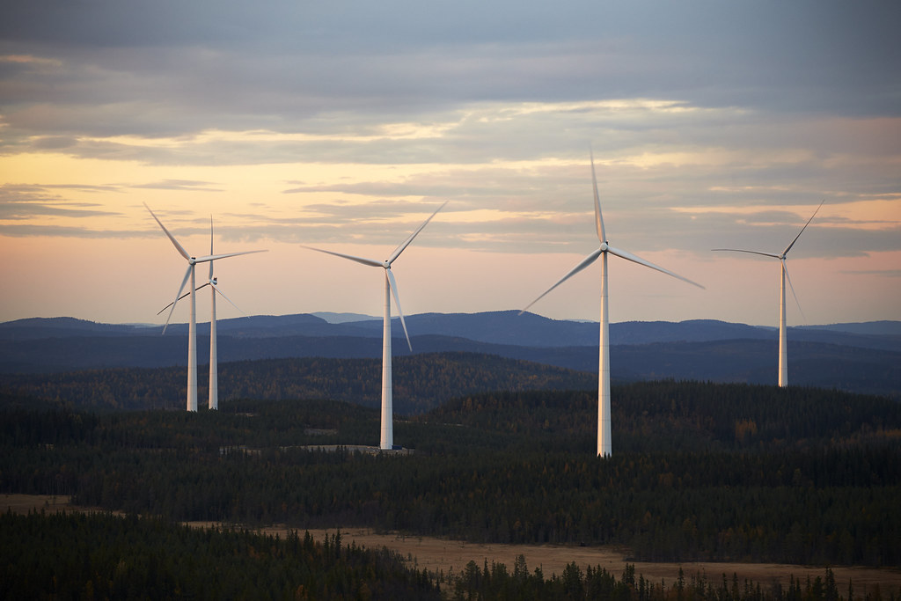
Introduction
Wind power continues to be one of the fastest growing and lowest-cost sources of electricity in the US (DoE 2023)
Large-scale onshore wind projects has a visual impact on our landscapes.
Conflicts scenic quality and visual aesthetics
This Photo by Unknown Author is licensed under CC BY-NC-ND
Chinna Subbaraya Siddharth Ramavajjala, MSc GIS & Cartography, Dept of Geography

Slide 4

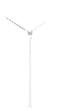
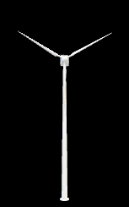
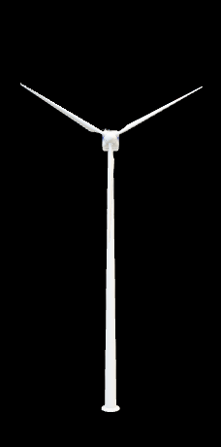
Key terms
Distance Zone: Effect of distance on how a turbine is perceived
Turbine-1
Turbine-2
Turbine-3
Turbine-3
Turbine-2
Turbine-1
Increasing Distance from observer
Chinna Subbaraya Siddharth Ramavajjala, MSc GIS & Cartography, Dept of Geography

Slide 5
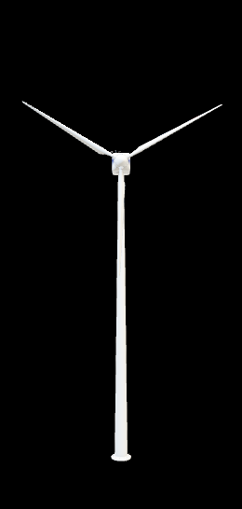
Key terms
Visual Exposure: The amount of turbine visible to observer at a relative height
Blade End Visibility
Hub Visibility
Rotor Sweep Visibility
Chinna Subbaraya Siddharth Ramavajjala, MSc GIS & Cartography, Dept of Geography

Slide 6
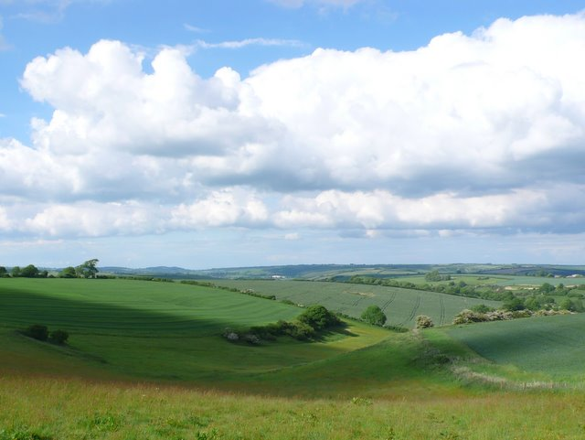
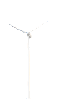
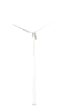
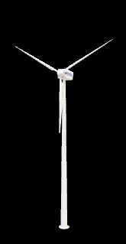
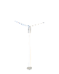
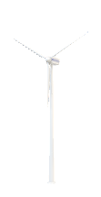
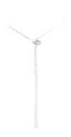
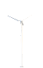
Key terms
Turbine Visual Prominence means “How prominent a turbine is”
Scenario-1
Scenario-2
Turbine-1 Turbine-2 Turbine-3
Turbine-1
Turbine-2
Chinna Subbaraya Siddharth Ramavajjala, MSc GIS & Cartography, Dept of Geography

Slide 7
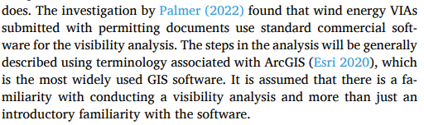

The Problem
Visual Impact Assessment (VIA) crucial and mandated as part of permitting process. (Shadow Flicker and Noise)
Without VIA or with flawed VIA can lead to sub-optimal site selection for wind projects
No open-source Python tools available to perform VIA except GRASS GIS
Chinna Subbaraya Siddharth Ramavajjala, MSc GIS & Cartography, Dept of Geography

Slide 8
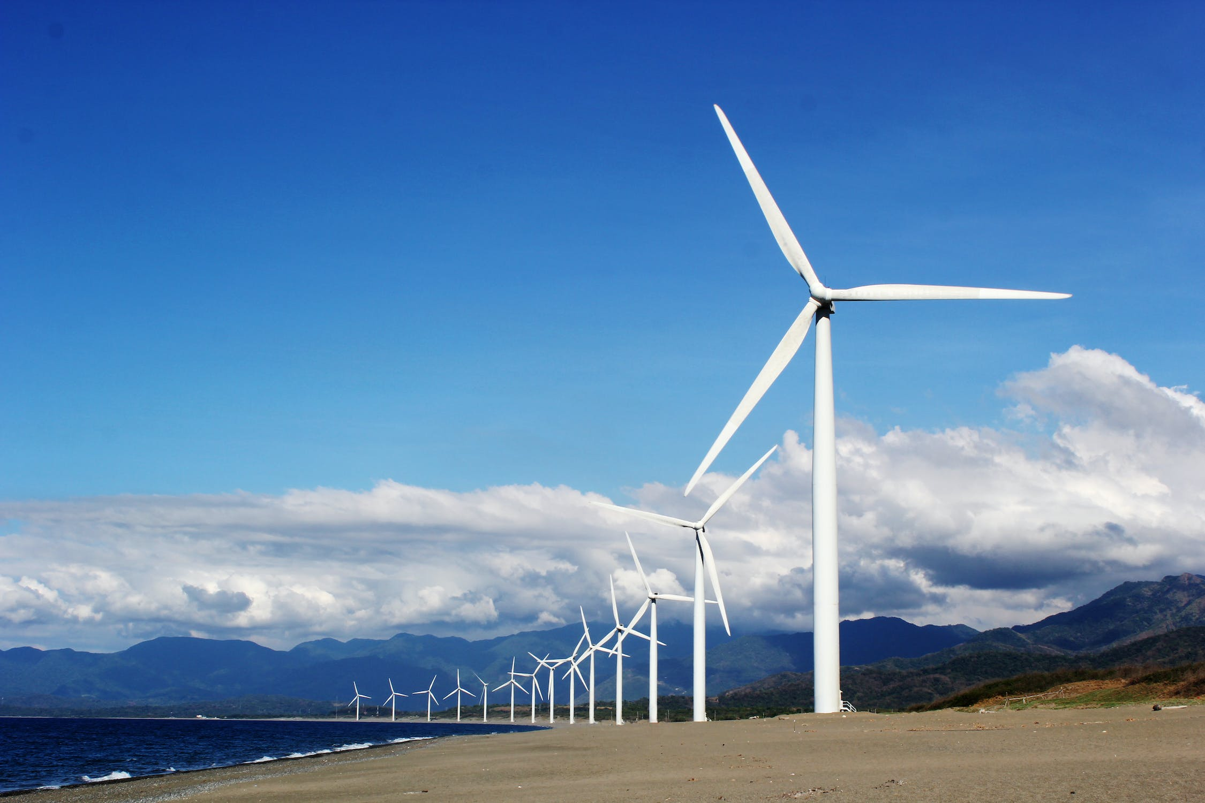
The Solution
To develop an open-source Python library viawind*
Python library that abstracts VIA geospatial workflow to a simple methods and performs
The library has to support visualization of geospatial data products and allow users to interact with outputs.
Chinna Subbaraya Siddharth Ramavajjala, MSc GIS & Cartography, Dept of Geography

Slide 9
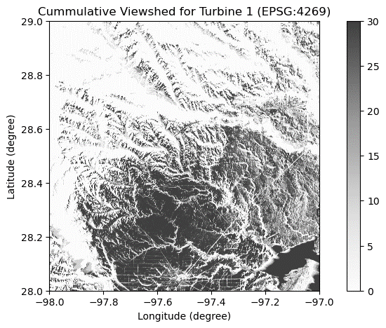
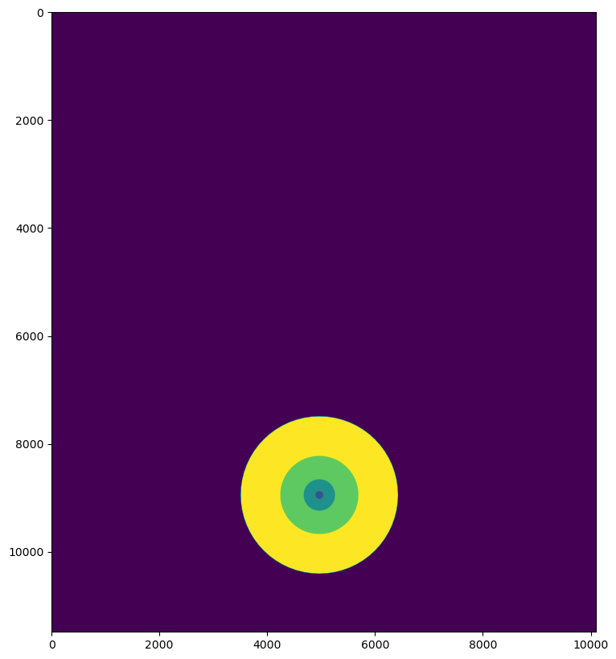
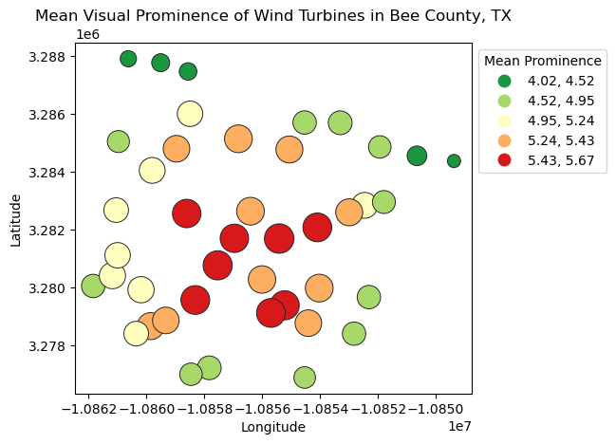
GIS Workflow
GDAL, Geopandas
0 – No Visibility
255 – Complete Visibility
Rasterio
Geopandas
Blade End [255:10]
Hub [255:20]
Rotor Sweep [255:30]
Store maximum in each pixel and calculate for each wind turbine
Wind Turbine Locations
Create for each location separately
Blade End
Compute Relative Viewsheds
Hub
Reclassify Relative Viewsheds
Merge Relative Viewsheds
Digital Elevation Model
Rasterio
Rotor Sweep
(Palmer 2022)
Create for each location separately
Rioxarray
Visual Exposure Raster
Shapely
Raster Sum (Visual Exposure, Distance Zone)
Rasterio
Compute Multi Ring Buffer
Rasterize Multi Ring Buffer
Distance Zone Raster
Merge Rasters
Immediate: 0 – 0.8 KM
Foreground: 0.8 – 3.2 KM
Near-Midground: 3.2 – 8 KM
Far-Midground: 8 – 16.1 KM
Background: 16.1 – 32.2 KM
Immediate: 1
Foreground: 2
Near-Midground: 3
Far-Midground: 4
Background: 5
(Palmer 2022)
(Palmer 2022)
Reclassify as per Table 3
Rasterio
Reclassify as per Table 4
Geopandas, Rasterio
Rasterio
Final Step
Mean Visual Prominence Raster
Visual Prominence Raster
Meaningful Visibility Raster
Raster Value Extraction
Rioxarray
Geopandas
Cumulative Visual Prominence
Cumulative Meaningful Visibility
Turbine Visual Prominence Bubble Plot
Rasterio
Raster Division

Slide 10
GIS Workflow
GDAL, Geopandas
0 – No Visibility
255 – Complete Visibility
Rasterio
Geopandas
Blade End [255:10]
Hub [255:20]
Rotor Sweep [255:30]
Store maximum in each pixel and calculate for each wind turbine
Wind Turbine Locations
Create for each location separately
Blade End
Compute Relative Viewsheds
Hub
Reclassify Relative Viewsheds
Merge Relative Viewsheds
Digital Elevation Model
Rasterio
Rotor Sweep
(Palmer 2022)
Create for each location separately
Rioxarray
Visual Exposure Raster
Shapely
Raster Sum (Visual Exposure, Distance Zone)
Rasterio
Compute Multi Ring Buffer
Rasterize Multi Ring Buffer
Distance Zone Raster
Merge Rasters
Immediate: 0 – 0.8 KM
Foreground: 0.8 – 3.2 KM
Near-Midground: 3.2 – 8 KM
Far-Midground: 8 – 16.1 KM
Background: 16.1 – 32.2 KM
Immediate: 1
Foreground: 2
Near-Midground: 3
Far-Midground: 4
Background: 5
(Palmer 2022)
(Palmer 2022)
Reclassify as per Table 3
Rasterio
Reclassify as per Table 4
Geopandas, Rasterio
Rasterio
Final Step
Mean Visual Prominence Raster
Visual Prominence Raster
Meaningful Visibility Raster
Raster Value Extraction
Rioxarray
Geopandas
Cumulative Visual Prominence
Cumulative Meaningful Visibility
Turbine Visual Prominence Bubble Plot
Rasterio
Raster Division

Slide 11
GIS Workflow
GDAL, Geopandas
0 – No Visibility
255 – Complete Visibility
Rasterio
Geopandas
Blade End [255:10]
Hub [255:20]
Rotor Sweep [255:30]
Store maximum in each pixel and calculate for each wind turbine
Wind Turbine Locations
Create for each location separately
Blade End
Compute Relative Viewsheds
Hub
Reclassify Relative Viewsheds
Merge Relative Viewsheds
Digital Elevation Model
Rasterio
Rotor Sweep
(Palmer 2022)
Create for each location separately
Rioxarray
Visual Exposure Raster
Shapely
Raster Sum (Visual Exposure, Distance Zone)
Rasterio
Compute Multi Ring Buffer
Rasterize Multi Ring Buffer
Distance Zone Raster
Merge Rasters
Immediate: 0 – 0.8 KM
Foreground: 0.8 – 3.2 KM
Near-Midground: 3.2 – 8 KM
Far-Midground: 8 – 16.1 KM
Background: 16.1 – 32.2 KM
Immediate: 1
Foreground: 2
Near-Midground: 3
Far-Midground: 4
Background: 5
(Palmer 2022)
(Palmer 2022)
Reclassify as per Table 3
Rasterio
Reclassify as per Table 4
Geopandas, Rasterio
Rasterio
Final Step
Mean Visual Prominence Raster
Visual Prominence Raster
Meaningful Visibility Raster
Raster Value Extraction
Rioxarray
Geopandas
Cumulative Visual Prominence
Cumulative Meaningful Visibility
Turbine Visual Prominence Bubble Plot
Rasterio
Raster Division

Slide 12
GIS Workflow
GDAL, Geopandas
0 – No Visibility
255 – Complete Visibility
Rasterio
Geopandas
Blade End [255:10]
Hub [255:20]
Rotor Sweep [255:30]
Store maximum in each pixel and calculate for each wind turbine
Wind Turbine Locations
Create for each location separately
Blade End
Compute Relative Viewsheds
Hub
Reclassify Relative Viewsheds
Merge Relative Viewsheds
Digital Elevation Model
Rasterio
Rotor Sweep
(Palmer 2022)
Create for each location separately
Rioxarray
Visual Exposure Raster
Shapely
Raster Sum (Visual Exposure, Distance Zone)
Rasterio
Compute Multi Ring Buffer
Rasterize Multi Ring Buffer
Distance Zone Raster
Merge Rasters
Immediate: 0 – 0.8 KM
Foreground: 0.8 – 3.2 KM
Near-Midground: 3.2 – 8 KM
Far-Midground: 8 – 16.1 KM
Background: 16.1 – 32.2 KM
Immediate: 1
Foreground: 2
Near-Midground: 3
Far-Midground: 4
Background: 5
(Palmer 2022)
(Palmer 2022)
Reclassify as per Table 3
Rasterio
Reclassify as per Table 4
Geopandas, Rasterio
Rasterio
Final Step
Mean Visual Prominence Raster
Visual Prominence Raster
Meaningful Visibility Raster
Raster Value Extraction
Rioxarray
Geopandas
Cumulative Visual Prominence
Cumulative Meaningful Visibility
Turbine Visual Prominence Bubble Plot
Rasterio
Raster Division

Slide 13
GIS Workflow
GDAL, Geopandas
0 – No Visibility
255 – Complete Visibility
Rasterio
Geopandas
Blade End [255:10]
Hub [255:20]
Rotor Sweep [255:30]
Store maximum in each pixel and calculate for each wind turbine
Wind Turbine Locations
Create for each location separately
Blade End
Compute Relative Viewsheds
Hub
Reclassify Relative Viewsheds
Merge Relative Viewsheds
Digital Elevation Model
Rasterio
Rotor Sweep
(Palmer 2022)
Create for each location separately
Rioxarray
Visual Exposure Raster
Shapely
Raster Sum (Visual Exposure, Distance Zone)
Rasterio
Compute Multi Ring Buffer
Rasterize Multi Ring Buffer
Distance Zone Raster
Merge Rasters
Immediate: 0 – 0.8 KM
Foreground: 0.8 – 3.2 KM
Near-Midground: 3.2 – 8 KM
Far-Midground: 8 – 16.1 KM
Background: 16.1 – 32.2 KM
Immediate: 1
Foreground: 2
Near-Midground: 3
Far-Midground: 4
Background: 5
(Palmer 2022)
(Palmer 2022)
Reclassify as per Table 3
Rasterio
Reclassify as per Table 4
Geopandas, Rasterio
Rasterio
Final Step
Mean Visual Prominence Raster
Visual Prominence Raster
Meaningful Visibility Raster
Raster Value Extraction
Rioxarray
Geopandas
Cumulative Visual Prominence
Cumulative Meaningful Visibility
Turbine Visual Prominence Bubble Plot
Rasterio
Raster Division

Slide 14
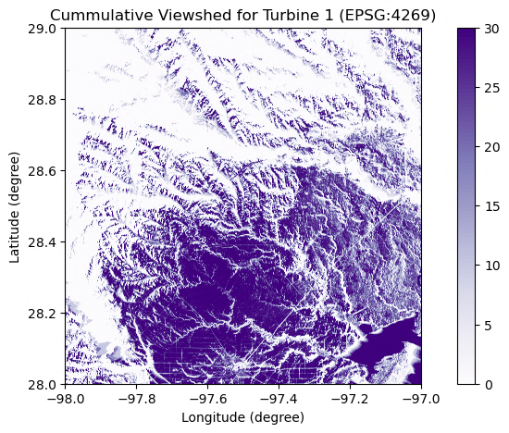
GIS Workflow
GDAL, Geopandas
0 – No Visibility
255 – Complete Visibility
Rasterio
Geopandas
Blade End [255:10]
Hub [255:20]
Rotor Sweep [255:30]
Store maximum in each pixel and calculate for each wind turbine
Wind Turbine Locations
Create for each location separately
Blade End
Compute Relative Viewsheds
Hub
Reclassify Relative Viewsheds
Merge Relative Viewsheds
Digital Elevation Model
Rasterio
Rotor Sweep
(Palmer 2022)
Create for each location separately
Rioxarray
Visual Exposure Raster
Shapely
Raster Sum (Visual Exposure, Distance Zone)
Rasterio
Compute Multi Ring Buffer
Rasterize Multi Ring Buffer
Distance Zone Raster
Merge Rasters
Immediate: 0 – 0.8 KM
Foreground: 0.8 – 3.2 KM
Near-Midground: 3.2 – 8 KM
Far-Midground: 8 – 16.1 KM
Background: 16.1 – 32.2 KM
Immediate: 1
Foreground: 2
Near-Midground: 3
Far-Midground: 4
Background: 5
(Palmer 2022)
(Palmer 2022)
Reclassify as per Table 3
Rasterio
Reclassify as per Table 4
Geopandas, Rasterio
Rasterio
Final Step
Mean Visual Prominence Raster
Visual Prominence Raster
Meaningful Visibility Raster
Raster Value Extraction
Rioxarray
Geopandas
Cumulative Visual Prominence
Cumulative Meaningful Visibility
Turbine Visual Prominence Bubble Plot
Rasterio
Raster Division

Slide 15

GIS Workflow
GDAL, Geopandas
0 – No Visibility
255 – Complete Visibility
Rasterio
Geopandas
Blade End [255:10]
Hub [255:20]
Rotor Sweep [255:30]
Store maximum in each pixel and calculate for each wind turbine
Wind Turbine Locations
Create for each location separately
Blade End
Compute Relative Viewsheds
Hub
Reclassify Relative Viewsheds
Merge Relative Viewsheds
Digital Elevation Model
Rasterio
Rotor Sweep
(Palmer 2022)
Create for each location separately
Rioxarray
Visual Exposure Raster
Shapely
Raster Sum (Visual Exposure, Distance Zone)
Rasterio
Compute Multi Ring Buffer
Rasterize Multi Ring Buffer
Distance Zone Raster
Merge Rasters
Immediate: 0 – 0.8 KM
Foreground: 0.8 – 3.2 KM
Near-Midground: 3.2 – 8 KM
Far-Midground: 8 – 16.1 KM
Background: 16.1 – 32.2 KM
Immediate: 1
Foreground: 2
Near-Midground: 3
Far-Midground: 4
Background: 5
(Palmer 2022)
(Palmer 2022)
Reclassify as per Table 3
Rasterio
Reclassify as per Table 4
Geopandas, Rasterio
Rasterio
Final Step
Mean Visual Prominence Raster
Visual Prominence Raster
Meaningful Visibility Raster
Raster Value Extraction
Rioxarray
Geopandas
Cumulative Visual Prominence
Cumulative Meaningful Visibility
Turbine Visual Prominence Bubble Plot
Rasterio
Raster Division

Slide 16
GIS Workflow
GDAL, Geopandas
0 – No Visibility
255 – Complete Visibility
Rasterio
Geopandas
Blade End [255:10]
Hub [255:20]
Rotor Sweep [255:30]
Store maximum in each pixel and calculate for each wind turbine
Wind Turbine Locations
Create for each location separately
Blade End
Compute Relative Viewsheds
Hub
Reclassify Relative Viewsheds
Merge Relative Viewsheds
Digital Elevation Model
Rasterio
Rotor Sweep
(Palmer 2022)
Create for each location separately
Rioxarray
Visual Exposure Raster
Shapely
Raster Sum (Visual Exposure, Distance Zone)
Rasterio
Compute Multi Ring Buffer
Rasterize Multi Ring Buffer
Distance Zone Raster
Merge Rasters
Immediate: 0 – 0.8 KM
Foreground: 0.8 – 3.2 KM
Near-Midground: 3.2 – 8 KM
Far-Midground: 8 – 16.1 KM
Background: 16.1 – 32.2 KM
Immediate: 1
Foreground: 2
Near-Midground: 3
Far-Midground: 4
Background: 5
(Palmer 2022)
(Palmer 2022)
Reclassify as per Table 3
Rasterio
Reclassify as per Table 4
Geopandas, Rasterio
Rasterio
Final Step
Mean Visual Prominence Raster
Visual Prominence Raster
Meaningful Visibility Raster
Raster Value Extraction
Rioxarray
Geopandas
Cumulative Visual Prominence
Cumulative Meaningful Visibility
Turbine Visual Prominence Bubble Plot
Rasterio
Raster Division

Slide 17
GIS Workflow
GDAL, Geopandas
0 – No Visibility
255 – Complete Visibility
Rasterio
Geopandas
Blade End [255:10]
Hub [255:20]
Rotor Sweep [255:30]
Store maximum in each pixel and calculate for each wind turbine
Wind Turbine Locations
Create for each location separately
Blade End
Compute Relative Viewsheds
Hub
Reclassify Relative Viewsheds
Merge Relative Viewsheds
Digital Elevation Model
Rasterio
Rotor Sweep
(Palmer 2022)
Create for each location separately
Rioxarray
Visual Exposure Raster
Shapely
Raster Sum (Visual Exposure, Distance Zone)
Rasterio
Compute Multi Ring Buffer
Rasterize Multi Ring Buffer
Distance Zone Raster
Merge Rasters
Immediate: 0 – 0.8 KM
Foreground: 0.8 – 3.2 KM
Near-Midground: 3.2 – 8 KM
Far-Midground: 8 – 16.1 KM
Background: 16.1 – 32.2 KM
Immediate: 1
Foreground: 2
Near-Midground: 3
Far-Midground: 4
Background: 5
(Palmer 2022)
(Palmer 2022)
Reclassify as per Table 3
Rasterio
Reclassify as per Table 4
Geopandas, Rasterio
Rasterio
Final Step
Mean Visual Prominence Raster
Visual Prominence Raster
Meaningful Visibility Raster
Raster Value Extraction
Rioxarray
Geopandas
Cumulative Visual Prominence
Cumulative Meaningful Visibility
Turbine Visual Prominence Bubble Plot
Rasterio
Raster Division

Slide 18
GIS Workflow
GDAL, Geopandas
0 – No Visibility
255 – Complete Visibility
Rasterio
Geopandas
Blade End [255:10]
Hub [255:20]
Rotor Sweep [255:30]
Store maximum in each pixel and calculate for each wind turbine
Wind Turbine Locations
Create for each location separately
Blade End
Compute Relative Viewsheds
Hub
Reclassify Relative Viewsheds
Merge Relative Viewsheds
Digital Elevation Model
Rasterio
Rotor Sweep
(Palmer 2022)
Create for each location separately
Rioxarray
Visual Exposure Raster
Shapely
Raster Sum (Visual Exposure, Distance Zone)
Rasterio
Compute Multi Ring Buffer
Rasterize Multi Ring Buffer
Distance Zone Raster
Merge Rasters
Immediate: 0 – 0.8 KM
Foreground: 0.8 – 3.2 KM
Near-Midground: 3.2 – 8 KM
Far-Midground: 8 – 16.1 KM
Background: 16.1 – 32.2 KM
Immediate: 1
Foreground: 2
Near-Midground: 3
Far-Midground: 4
Background: 5
(Palmer 2022)
(Palmer 2022)
Reclassify as per Table 3
Rasterio
Reclassify as per Table 4
Geopandas, Rasterio
Rasterio
Final Step
Mean Visual Prominence Raster
Visual Prominence Raster
Meaningful Visibility Raster
Raster Value Extraction
Rioxarray
Geopandas
Cumulative Visual Prominence
Cumulative Meaningful Visibility
Turbine Visual Prominence Bubble Plot
Rasterio
Raster Division

Slide 19
GIS Workflow
GDAL, Geopandas
0 – No Visibility
255 – Complete Visibility
Rasterio
Geopandas
Blade End [255:10]
Hub [255:20]
Rotor Sweep [255:30]
Store maximum in each pixel and calculate for each wind turbine
Wind Turbine Locations
Create for each location separately
Blade End
Compute Relative Viewsheds
Hub
Reclassify Relative Viewsheds
Merge Relative Viewsheds
Digital Elevation Model
Rasterio
Rotor Sweep
(Palmer 2022)
Create for each location separately
Rioxarray
Visual Exposure Raster
Shapely
Raster Sum (Visual Exposure, Distance Zone)
Rasterio
Compute Multi Ring Buffer
Rasterize Multi Ring Buffer
Distance Zone Raster
Merge Rasters
Immediate: 0 – 0.8 KM
Foreground: 0.8 – 3.2 KM
Near-Midground: 3.2 – 8 KM
Far-Midground: 8 – 16.1 KM
Background: 16.1 – 32.2 KM
Immediate: 1
Foreground: 2
Near-Midground: 3
Far-Midground: 4
Background: 5
(Palmer 2022)
(Palmer 2022)
Reclassify as per Table 3
Rasterio
Reclassify as per Table 4
Geopandas, Rasterio
Rasterio
Final Step
Mean Visual Prominence Raster
Visual Prominence Raster
Meaningful Visibility Raster
Raster Value Extraction
Rioxarray
Geopandas
Cumulative Visual Prominence
Cumulative Meaningful Visibility
Turbine Visual Prominence Bubble Plot
Rasterio
Raster Division

Slide 20
GIS Workflow
GDAL, Geopandas
0 – No Visibility
255 – Complete Visibility
Rasterio
Geopandas
Blade End [255:10]
Hub [255:20]
Rotor Sweep [255:30]
Store maximum in each pixel and calculate for each wind turbine
Wind Turbine Locations
Create for each location separately
Blade End
Compute Relative Viewsheds
Hub
Reclassify Relative Viewsheds
Merge Relative Viewsheds
Digital Elevation Model
Rasterio
Rotor Sweep
(Palmer 2022)
Create for each location separately
Rioxarray
Visual Exposure Raster
Shapely
Raster Sum (Visual Exposure, Distance Zone)
Rasterio
Compute Multi Ring Buffer
Rasterize Multi Ring Buffer
Distance Zone Raster
Merge Rasters
Immediate: 0 – 0.8 KM
Foreground: 0.8 – 3.2 KM
Near-Midground: 3.2 – 8 KM
Far-Midground: 8 – 16.1 KM
Background: 16.1 – 32.2 KM
Immediate: 1
Foreground: 2
Near-Midground: 3
Far-Midground: 4
Background: 5
(Palmer 2022)
(Palmer 2022)
Reclassify as per Table 3
Rasterio
Reclassify as per Table 4
Geopandas, Rasterio
Rasterio
Final Step
Mean Visual Prominence Raster
Visual Prominence Raster
Meaningful Visibility Raster
Raster Value Extraction
Rioxarray
Geopandas
Cumulative Visual Prominence
Cumulative Meaningful Visibility
Turbine Visual Prominence Bubble Plot
Rasterio
Raster Division

Slide 21
GIS Workflow
GDAL, Geopandas
0 – No Visibility
255 – Complete Visibility
Rasterio
Geopandas
Blade End [255:10]
Hub [255:20]
Rotor Sweep [255:30]
Store maximum in each pixel and calculate for each wind turbine
Wind Turbine Locations
Create for each location separately
Blade End
Compute Relative Viewsheds
Hub
Reclassify Relative Viewsheds
Merge Relative Viewsheds
Digital Elevation Model
Rasterio
Rotor Sweep
(Palmer 2022)
Create for each location separately
Rioxarray
Visual Exposure Raster
Shapely
Raster Sum (Visual Exposure, Distance Zone)
Rasterio
Compute Multi Ring Buffer
Rasterize Multi Ring Buffer
Distance Zone Raster
Merge Rasters
Immediate: 0 – 0.8 KM
Foreground: 0.8 – 3.2 KM
Near-Midground: 3.2 – 8 KM
Far-Midground: 8 – 16.1 KM
Background: 16.1 – 32.2 KM
Immediate: 1
Foreground: 2
Near-Midground: 3
Far-Midground: 4
Background: 5
(Palmer 2022)
(Palmer 2022)
Reclassify as per Table 3
Rasterio
Reclassify as per Table 4
Geopandas, Rasterio
Rasterio
Final Step
Mean Visual Prominence Raster
Visual Prominence Raster
Meaningful Visibility Raster
Raster Value Extraction
Rioxarray
Geopandas
Cumulative Visual Prominence
Cumulative Meaningful Visibility
Turbine Visual Prominence Bubble Plot
Rasterio
Raster Division

Slide 22
GIS Workflow
GDAL, Geopandas
0 – No Visibility
255 – Complete Visibility
Rasterio
Geopandas
Blade End [255:10]
Hub [255:20]
Rotor Sweep [255:30]
Store maximum in each pixel and calculate for each wind turbine
Wind Turbine Locations
Create for each location separately
Blade End
Compute Relative Viewsheds
Hub
Reclassify Relative Viewsheds
Merge Relative Viewsheds
Digital Elevation Model
Rasterio
Rotor Sweep
(Palmer 2022)
Create for each location separately
Rioxarray
Visual Exposure Raster
Shapely
Raster Sum (Visual Exposure, Distance Zone)
Rasterio
Compute Multi Ring Buffer
Rasterize Multi Ring Buffer
Distance Zone Raster
Merge Rasters
Immediate: 0 – 0.8 KM
Foreground: 0.8 – 3.2 KM
Near-Midground: 3.2 – 8 KM
Far-Midground: 8 – 16.1 KM
Background: 16.1 – 32.2 KM
Immediate: 1
Foreground: 2
Near-Midground: 3
Far-Midground: 4
Background: 5
(Palmer 2022)
(Palmer 2022)
Reclassify as per Table 3
Rasterio
Reclassify as per Table 4
Geopandas, Rasterio
Rasterio
Final Step
Mean Visual Prominence Raster
Visual Prominence Raster
Meaningful Visibility Raster
Raster Value Extraction
Rioxarray
Geopandas
Cumulative Visual Prominence
Cumulative Meaningful Visibility
Turbine Visual Prominence Bubble Plot
Rasterio
Raster Division

Slide 23
GIS Workflow
GDAL, Geopandas
0 – No Visibility
255 – Complete Visibility
Rasterio
Geopandas
Blade End [255:10]
Hub [255:20]
Rotor Sweep [255:30]
Store maximum in each pixel and calculate for each wind turbine
Wind Turbine Locations
Create for each location separately
Blade End
Compute Relative Viewsheds
Hub
Reclassify Relative Viewsheds
Merge Relative Viewsheds
Digital Elevation Model
Rasterio
Rotor Sweep
(Palmer 2022)
Create for each location separately
Rioxarray
Visual Exposure Raster
Shapely
Raster Sum (Visual Exposure, Distance Zone)
Rasterio
Compute Multi Ring Buffer
Rasterize Multi Ring Buffer
Distance Zone Raster
Merge Rasters
Immediate: 0 – 0.8 KM
Foreground: 0.8 – 3.2 KM
Near-Midground: 3.2 – 8 KM
Far-Midground: 8 – 16.1 KM
Background: 16.1 – 32.2 KM
Immediate: 1
Foreground: 2
Near-Midground: 3
Far-Midground: 4
Background: 5
(Palmer 2022)
(Palmer 2022)
Reclassify as per Table 3
Rasterio
Reclassify as per Table 4
Geopandas, Rasterio
Rasterio
Final Step
Mean Visual Prominence Raster
Visual Prominence Raster
Meaningful Visibility Raster
Raster Value Extraction
Rioxarray
Geopandas
Cumulative Visual Prominence
Cumulative Meaningful Visibility
Turbine Visual Prominence Bubble Plot
Rasterio
Raster Division

Slide 24
GIS Workflow
GDAL, Geopandas
0 – No Visibility
255 – Complete Visibility
Rasterio
Geopandas
Blade End [255:10]
Hub [255:20]
Rotor Sweep [255:30]
Store maximum in each pixel and calculate for each wind turbine
Wind Turbine Locations
Create for each location separately
Blade End
Compute Relative Viewsheds
Hub
Reclassify Relative Viewsheds
Merge Relative Viewsheds
Digital Elevation Model
Rasterio
Rotor Sweep
(Palmer 2022)
Create for each location separately
Rioxarray
Visual Exposure Raster
Shapely
Raster Sum (Visual Exposure, Distance Zone)
Rasterio
Compute Multi Ring Buffer
Rasterize Multi Ring Buffer
Distance Zone Raster
Merge Rasters
Immediate: 0 – 0.8 KM
Foreground: 0.8 – 3.2 KM
Near-Midground: 3.2 – 8 KM
Far-Midground: 8 – 16.1 KM
Background: 16.1 – 32.2 KM
Immediate: 1
Foreground: 2
Near-Midground: 3
Far-Midground: 4
Background: 5
(Palmer 2022)
(Palmer 2022)
Reclassify as per Table 3
Rasterio
Reclassify as per Table 4
Geopandas, Rasterio
Rasterio
Final Step
Mean Visual Prominence Raster
Visual Prominence Raster
Meaningful Visibility Raster
Raster Value Extraction
Rioxarray
Geopandas
Cumulative Visual Prominence
Cumulative Meaningful Visibility
Turbine Visual Prominence Bubble Plot
Rasterio
Raster Division

Slide 25
GIS Workflow
GDAL, Geopandas
0 – No Visibility
255 – Complete Visibility
Rasterio
Geopandas
Blade End [255:10]
Hub [255:20]
Rotor Sweep [255:30]
Store maximum in each pixel and calculate for each wind turbine
Wind Turbine Locations
Create for each location separately
Blade End
Compute Relative Viewsheds
Hub
Reclassify Relative Viewsheds
Merge Relative Viewsheds
Digital Elevation Model
Rasterio
Rotor Sweep
(Palmer 2022)
Create for each location separately
Rioxarray
Visual Exposure Raster
Shapely
Raster Sum (Visual Exposure, Distance Zone)
Rasterio
Compute Multi Ring Buffer
Rasterize Multi Ring Buffer
Distance Zone Raster
Merge Rasters
Immediate: 0 – 0.8 KM
Foreground: 0.8 – 3.2 KM
Near-Midground: 3.2 – 8 KM
Far-Midground: 8 – 16.1 KM
Background: 16.1 – 32.2 KM
Immediate: 1
Foreground: 2
Near-Midground: 3
Far-Midground: 4
Background: 5
(Palmer 2022)
(Palmer 2022)
Reclassify as per Table 3
Rasterio
Reclassify as per Table 4
Geopandas, Rasterio
Rasterio
Final Step
Mean Visual Prominence Raster
Visual Prominence Raster
Meaningful Visibility Raster
Raster Value Extraction
Rioxarray
Geopandas
Cumulative Visual Prominence
Cumulative Meaningful Visibility
Turbine Visual Prominence Bubble Plot
Rasterio
Raster Division

Slide 26

Live Demo
Github repository QR code and Jupyter notebook is also available with sample datasets
Chinna Subbaraya Siddharth Ramavajjala, MSc GIS & Cartography, Dept of Geography

Slide 27
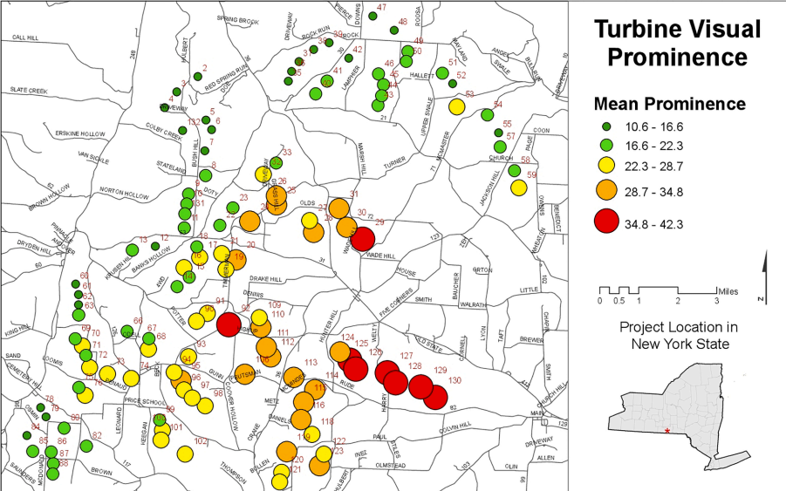
Introduction
Chinna Subbaraya Siddharth Ramavajjala, MSc GIS & Cartography, Dept of Geography

Slide 28
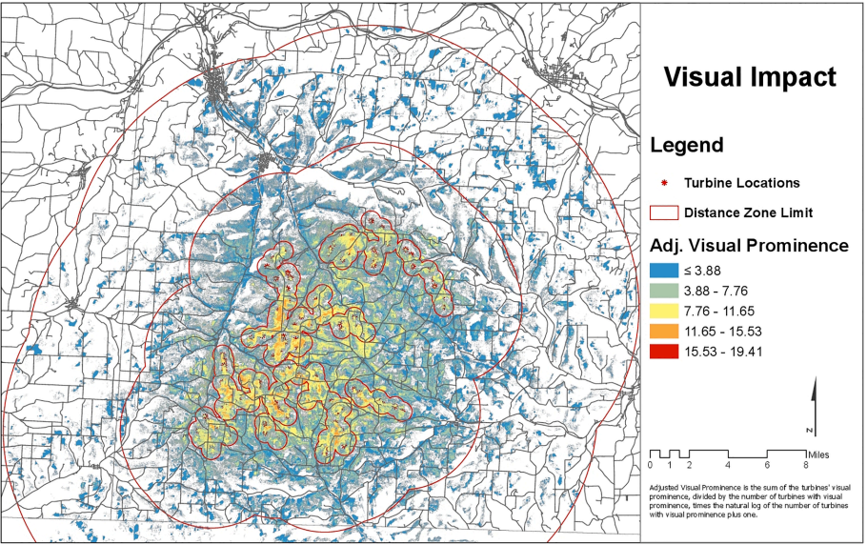
Chinna Subbaraya Siddharth Ramavajjala, MSc GIS & Cartography, Dept of Geography

Slide 29





Progress
Perform data engineering, literature review, design Python functions
Test code to handle exceptions and package code
Scoping
Packaging and Testing
Planning
Visual Impact Assessment
Deployment
Download required datasets for area of interest (AoI)
Create package method for viewshed analysis, buffer analysis and GIS pipeline execution
Deploy alpha version for the demonstration
Chinna Subbaraya Siddharth Ramavajjala, MSc GIS & Cartography, Dept of Geography

Slide 30
Future work
Deploy a beta version and improve the code robustly with loggers.
Develop setup.py to accommodates GDAL command line and c-binaries installation across different operating systems (OS).
Develop and debug code using pytests
Add methods to interactive visualization and integrate USGS National Map API, US Wind Turbine Database API to allow higher level abstraction of the analysis.
Optimize and refactor parts of code to achieve coding efficiency and memory usage.
Chinna Subbaraya Siddharth Ramavajjala, MSc GIS & Cartography, Dept of Geography

Slide 31
Credits
Professor JF Palmer, State University of New York College (SUNY)
Travis Williams, National Renewable Energy Laboratory (NREL)
Professor William Gartner, Dept of Geography, University of Wisconsin – Madison
Professor Randy Sincoular, Dept of Geography, University of Wisconsin – Madison
Mahitha Pillodi, Dept of Computer Sciences, University of Wisconsin – Madison
Chinna Subbaraya Siddharth Ramavajjala, MSc GIS & Cartography, Dept of Geography

